Slide 2
Testing your Xamarin Apps
Codrina Merigo
Software Engineer
Fresenius Medical Care

Slide 3
Intro

Slide 4
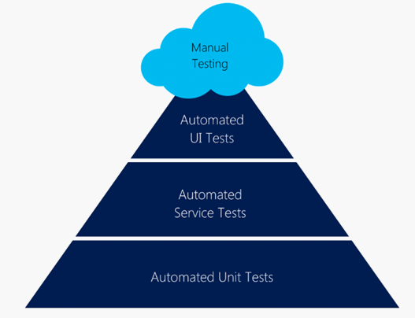
App Testing
View
UI Tests This is the layer where you would be testing
the product more from an end-user’s perspective.
Your top priority would be to ensure that ‘UI Design Flow’
is in-line with the design requirements.
Service Tests helps you ensure that the services
are working properly and give you the right data.
ViewModel
Unit Tests are normally written by the developers who write test code to verify the functionalities that were developed by them.
Notes:
The Model-View-ViewModel (MVVM) pattern helps to cleanly separate the business and presentation logic of an application from its user interface (UI).
Maintaining a clean separation between application logic and the UI helps to address numerous development issues and can make an application easier to test, maintain, and evolve. It can also greatly improve code re-use opportunities and allows developers and UI designers to more easily collaborate when developing their respective parts of an app.

Slide 5
FIRST Principles
Fast - tests are slow but devs must try not to write them even slower
Independent - not use other tests
Repeatable - not use constants like access tokens
Self-validating - by using asserts
Timely - try not to be very complicated, maybe an action can be split in multiple tests

Slide 6
AAA Pattern
Arrange, Act, Assert
Sample
public int MySum(int a, int b)
{
return a + b;
}
[Test]
public void TestMySum()
{
// Arrange
int a = 5;
int b = 7;
// Act
int result = MySum(a, b);
// Assert
Assert.AreEqual(12, result);
}
Notes:
Common pattern used for unit and ui testing

Slide 7
Unit Testing

Slide 8
A unit test takes a small unit of the app, typically a method, isolates it from the remainder of the code, and verifies that it behaves as expected. Its goal is to check that each unit of functionality performs as expected, so that errors don't propagate throughout the app.
Notes:
Unit testing has the greatest effect on code quality when it's an integral part of the software development workflow. As soon as a method has been written, unit tests should be written that verify the behavior of the method in response to standard, boundary, and incorrect cases of input data, and that check any explicit or implicit assumptions made by the code. Alternatively, with test driven development, unit tests are written before the code. In this scenario, unit tests act as both design documentation and functional specifications.
Testing models and view models from MVVM applications is identical to testing any other classes, and the same tools and techniques – such as unit testing and mocking, can be used.

Slide 9
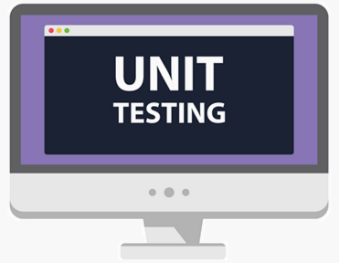
Why do we Unit Test?
Test system functionalities
Test small part of the application at once
Identify and simplify architecture
Identity bugs earlier
Avoid regressions

Slide 10




Unit Test Frameworks
Testing view models from MVVM applications is identical to testing any other classes and many .NET and c# Frameworks can be used.
nUnit
xUnit.net
VSTest

Slide 11
Unit test your own code
Use a mock (or moq) service to create instances of your interfaces.
When unit testing a Xamarin.Forms view model, don’t focus on things like Bindings, JSON parsers, Plugins or purely Xamarin.Forms features as they are tested by the Xamarin.Teams.
Test your commands and logic from view models.
Based on the selected framework, use the proper test decorations.
IntelliTest can help you!

Slide 12
Interface everything
In your Unit Test project, you can add any plugin or nuget package you might use in your app and even Xamarin.Essentials.
Creating your own IXamarinEssentials, and exposing only the methods and properties you would like to use, gives more flexibility.
Sample
public class MockConnectivity : IConnectivity
{
public bool IsConnected => true;
public IEnumerable<ConnectionType> ConnectionTypes => new[] { ConnectionType.WiFi };
public IEnumerable<ulong> Bandwidths => new[] { (ulong)4000 };
public event ConnectivityChangedEventHandler ConnectivityChanged;
public event ConnectivityTypeChangedEventHandler ConnectivityTypeChanged;
…
}
Notes:
Using this type of architecture will enable you to work with unit testing.

Slide 13

Demo

Slide 14
UI Testing

Slide 15
Since the testing at UI level is so fragile,
it is recommended to focus on these tests
to only verify ‘UI flow & interactions’
without looking into the system functionality.
Notes:
System functionalities already covered by unit tests

Slide 16
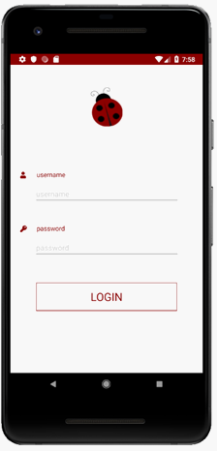
How would you test UI manually?
E.g.: login.
Enter username and password
Tap Login
Locate the username field -> interaction: type your name into the field
Repeat for the password
Locate and tap the Sign In button
Ensure you have logged in

Slide 17
The two main tasks that you do manually are: Locate the element you want and
Interact with it
1
2
You will do the same in your automated UI Test!

Slide 18
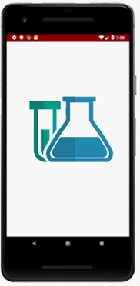
What should you UI Test for?
Verify your views and controls on the screen
Check for navigation between pages
Interact with ‘live’ elements like buttons, checkboxes, switches or tabs

Slide 19

BDD Approach
Given
When
Then
Behavior Driven Development
This process allows you to write tests in a non-technical language that everyone can understand (e.g. a domain-specific language like Gherkin).
BDD forms an approach for building a shared understanding on what kind of software to build by discussing examples.
Sample
As a registered user,
I want to be able to login,
so that I can see the Application.
Scenario 1: User is able to log in.
Given that I am a registered user,
when I enter the username ‘Codrina’
and password ‘ladybug’,
then I should see
the first screen of the app.
As a [role]
I want [feature]
So that [benefit]

Slide 20
UI Automation is supposed to run slow in order to emulate an actual user interaction - keep that in mind that sometimes we may wait for an element to pop on the screen before we verify if it is actually on the screen.

Slide 21
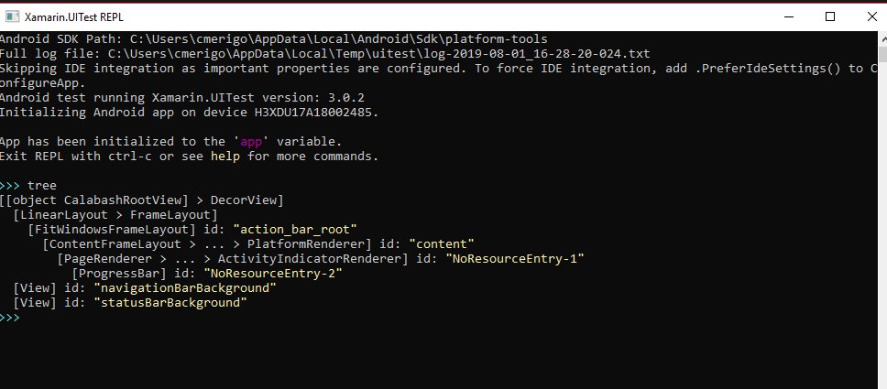
Repl() - read-eval-print-loop
The REPL is a console-like environment in which the developer enters expressions or commands.
It will then evaluate those expressions and display the results to the user.
tree
app.Query(e => e.All())
app.Flash(e=>e.All())
Notes:
Iapp.Flash

Slide 22
The REPL is helpful when creating UITests as it allows us to explore the user interface and create the queries and statements so that the test may interact with the application.
Notes:
Iapp.Flash

Slide 23
Demo

Slide 24
Meet the AutomationId
In order to identify a control on the screen, each control needs an unique identifier called AutomationId set to the visual element, for example:
<Label x:Name="label1" AutomationId="MyLabel" Text="Hello, Xamarin.Forms!" />
Or
var label1 = new Label {
Text = "Hello, Xamarin.Forms!",
AutomationId = "MyLabel"
};
It’s important also to write every single action and
not take anything for granted
Notes:
(for example: the keyboard pops on the screen, an input text is always empty,
the keyboard disappears or hides a part of the screen which contains the ‘Login’ button,
the popup is shown and is completely loaded)

Slide 25
Queries inside and outside Repl()
Samples
//label
bool myLabel = app.Query(e => e.Marked(“MyLabel")).Any();
app.Tap(“MyLabel");
//swipe gestures
app.SwipeLeftToRight();
//entry
app.Tap(“MyEntry");
app.EnterText(Constants.Value);
app.DismissKeyboard();
//inside webview
/*through Safari for iOS and through Chrome for Android use the browser developer tools to visually identify the elements inside the DOM.*/
app.Tap(c => c.WebView().Css("#element"));

Slide 26
Demo

Slide 27
Interacting with elements
Waiting
IApp.WaitForElement
IApp.WaitForNoElement
app.WaitForElement(c=>c.Marked(”MyLabel”),“Did not see MyLabel”.",
new TimeSpan(0,0,0,90,0));
Scrolling
IApp.ScrollDownTo
app.ScrollDownTo(c =>e.Marked(“MyLabel"));
Notes:
Sometimes it is necessary to pause test execution while waiting for the user interface to update while a long running action is in progress. UITest provides two API's to address these concerns:
May happen that the element you want to interact to, is down in the page, away from your viewport so a scrolling action must be performed.

Slide 28
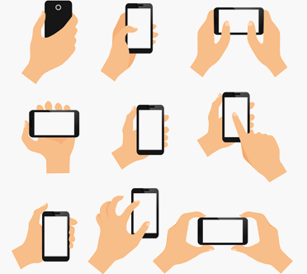
Impersonate user
Gestures
IApp.DoubleTap – Two quick taps on the first matched view.
IApp.DragCoordinates – Continuous drag between two points.
IApp.PinchToZoomIn – Pinch gesture on the matched view to zoom in.
IApp.PinchToZoomOut – Pinch gesture on the matched view to zoom out.
IApp.ScrollUp / IApp.ScrollDown – Touch gesture that scrolls down or up.
IApp.SwipeLeftToRight / IApp.RightToLeft – Left-to-right or right-to-left gesture swipe.
IApp.Tap – Taps the first matched element.
IApp.TouchAndHold – Continuously touches the view.
app.DoubleTap(c=>c.Marked (“MyLabel"));
Notes:
UITest provides a very large number of APIs to simulate gestures or interactions with the device. E.g.:

Slide 29
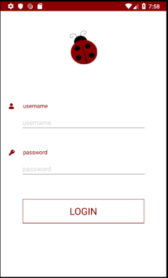
Screenshots
At any time, in your ui test, you can take a screenshot of the current view for further checks or you might want to take a screenshot if a test is not passing.
Screenshots saved with App.Screenshot() are located in your test project's directory: MyTestProject"\bin\Debug folder
app.Screenshot(“MyScreenshot");
Useful to track broken UI from failed tests or for quality reports.

Slide 30
Writing the test in natural language and performing them manually before coding them can help you write complete automated tests.
Notes:
toQuery – this is a UITest web query that will locate a DOM element in the web view.
withinMarked – this is a string that will located the web view on the screen. This parameter is optional if there is only one web view on the screen. This string will used by IApp.Marked to locate the web view on the screen.
strategy – this optional parameter tells UITest how to scroll within the web view. ScrollStrategy.Gesture will try to emulate how a user would scroll, by dragging the screen. ScrollStrategy.Programatic frees up UITest to scroll in the quickest way possible. ScrollStrategy.Auto tells UITest to use any combination of Gesture and Programatic to scroll (with a preference to Programatic).
timeout – an optional parameter that specifies how long UITest should wait before timing out the query.

Slide 31
Running your tests

Slide 32
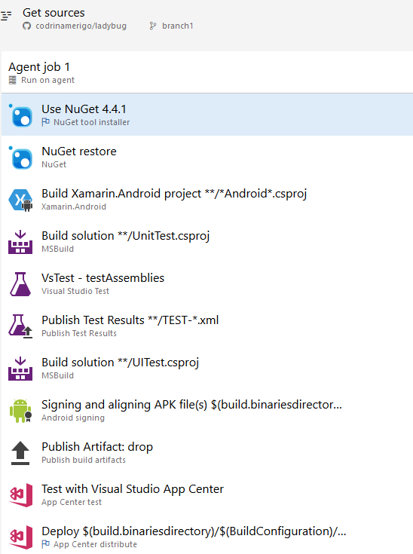

Add your Unit Tests to your DevOps pipeline

Slide 33
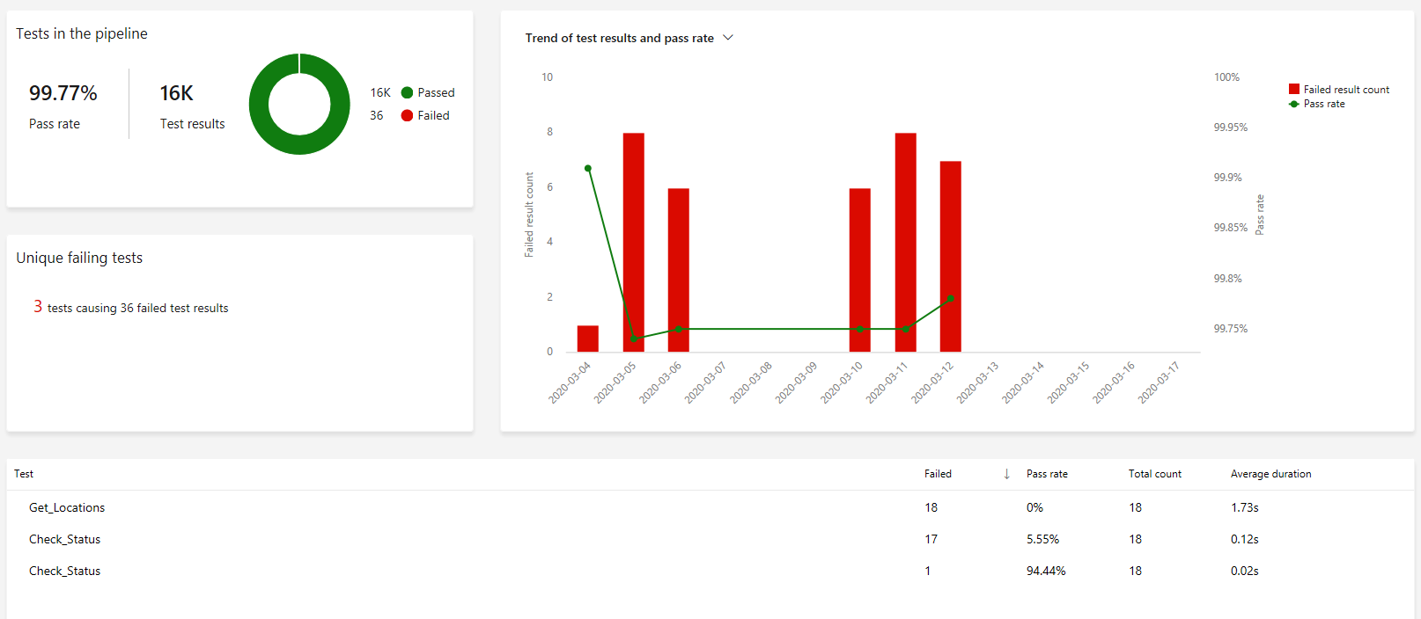
DevOps Test Reports
https://dev.azure.com/xamarin/public/_test/analytics?definitionId=7&contextType=build

Slide 34
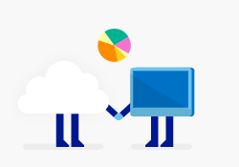
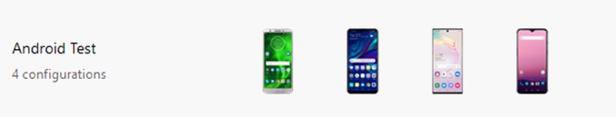








Run your UI tests on App Center Test Cloud
Run on first device when ready
Configure your run by selecting
Upload package and UI Test
using nodeJs and following
app center instruction
appCenter
Validation
Wait for
devices
Run on second device when ready
Generate report for results
Run on third device when ready
Run on nth device when ready

Slide 35

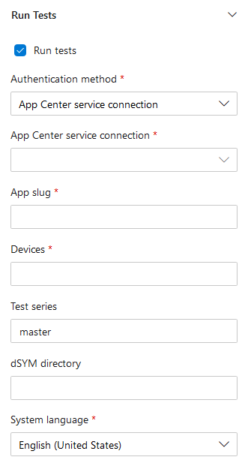

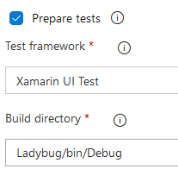
Add UI Tests to DevOps using AppCenter
Enable task
From app center you get:
appcenter test run uitest
--app "codrinamerigo/LadyBug"
--devices "codrinamerigo/android-test"
--app-path pathToFile.apk
--test-series "master"
--locale "en_US"
--build-dir pathToUITestBuildDir

Slide 36
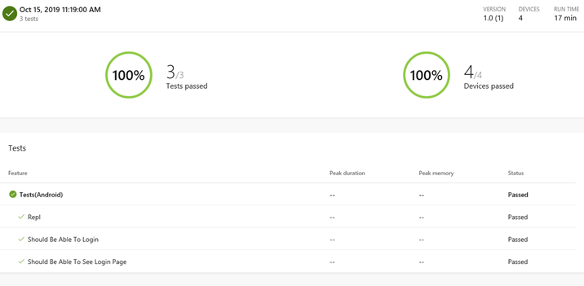
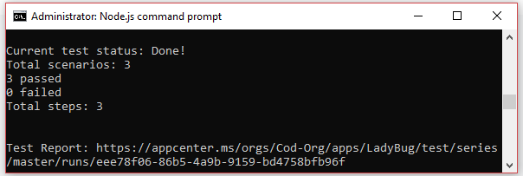
App Center Test Cloud Reports

Slide 37
Keep your tests alive!

Slide 38
Q & A

Slide 39
Thank you
@_Codrina_

